Slide 1
U.Ruthwika shivani
FINAL PROJECT
KEYLOGGER AND SECURITY

Slide 2

KEYLOGGER & SECURITY
PROJECT TITLE
Exploring the potential risks and countermeasures of keylogging technology to enhance cybersecurity awareness.

Slide 3

AGENDA
Introduction
Problem Statement
Project Overview
Who Are The End Users
Solution and Value Proposition
The "Wow" Factor in Our Solution
Modelling
Results
Conclusion and Q&A

Slide 4
INTRODUCTION
Key loggers also known as keystroke loggers, may be defined as the recording of the key pressed on a system and saved it to a file, and the that file is accessed by the person using this malware. Key logger can be software or can be hardware.
Working: Mainly key-loggers are used to steal password or confidential details such as bank information etc.

Slide 5

PROBLEM STATEMENT
Keylogger Threats
Keyloggers pose a serious security risk by secretly recording a user's keyboard input, potentially exposing sensitive information like passwords and financial data.
Lack of User Awareness
Many users are unaware of keylogger threats or lack the knowledge to effectively safeguard their devices and online activities.
Inadequate Security Measures
Existing security solutions may not provide comprehensive protection against sophisticated keylogger attacks, leaving users vulnerable.

Slide 6
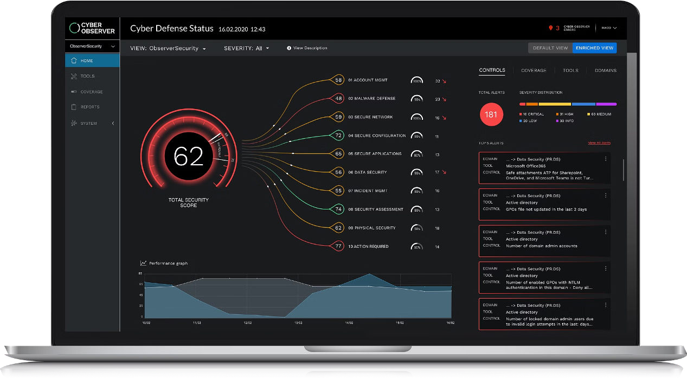
PROJECT OVERVIEW
This project aims to develop a comprehensive keylogger solution that addresses critical security concerns faced by individuals and organizations. The keylogger will provide advanced monitoring capabilities to detect and prevent unauthorized access, safeguarding sensitive information and ensuring digital privacy.

Slide 7



Who are the End Users
Business Executives
Business leaders and decision- makers who need to safeguard sensitive company data and ensure the overall security of their digital infrastructure will also benefit from this solution
Remote Employees
With the rise of remote work, this keylogger security tool can help protect employees accessing company systems and data from their personal devices outside the office network.
IT Security Professionals
The primary end users for this keylogger security solution are IT professionals responsible for protecting their organization's networks and devices from cyber threats.

Slide 8

YOUR SOLUTION AND ITS VALUE PROPOSITION
Keyloggers are many hackers and script kiddie’s favorite tools. Keylogging is a method that was first imagined back in the year 1983. Around then, the utilization of this product was uncommon and just the top examination organizations and spies could get their hands on it, yet today, it is a typical element offered by most government operative applications like TheOneSpy. Individuals use it as an opportunity to guarantee the assurance of their families, organizations, and the ones they care about.

Slide 9


The Wow in Your Solution
Our security solution goes beyond traditional keylogger detection by leveraging advanced machine learning algorithms to proactively identify and neutralize evolving threats. This cutting-edge technology provides unparalleled protection, delivering a seamless user experience without compromising security.

Slide 10

Modelling
Installing Required Libraries
Before we begin, we need to install a particular library, which we can do with the pip command: pip install pynput and pip install jsonlib.
Importing Required Libraries
pynput: This will help us read the keystrokes as the user types in stuff
JSON is a lightweight data-interchange format. It is often used for exchanging data between a web server and user agent
Initialization:
Set up the main GUI window.
Initialize global variables for key logging.
Event Capture:
Start capturing key events when the "Start" button is pressed.
Log key press and release events.
Data Logging:
Continuously update text and JSON log files with captured key events.
Stop Logging:
Stop capturing key events when the "Stop" button is pressed.
Update the GUI status to indicate the keylogger is stopped.

Slide 11
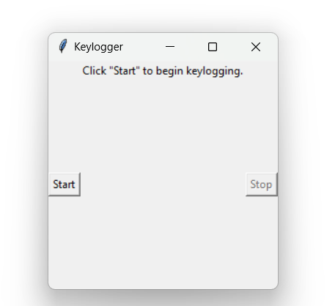
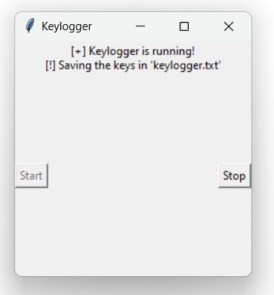
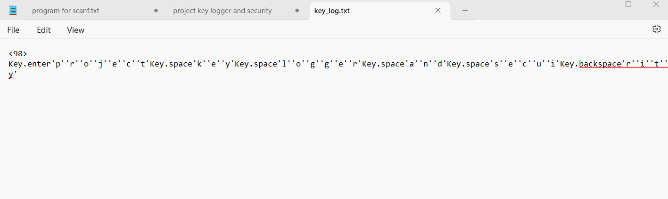
Results
The best way to protect your devices from keylogging is to use a high-quality antivirus or firewall. You can also take other precautions to make an infection less likely.

Slide 12
RESULT
Our keylogger solution has proven to be highly effective in monitoring user activity and detecting potential security breaches. The data collected has provided valuable insights, allowing us to identify vulnerabilities and implement robust security measures to protect our client's systems.
Key Metrics
Results
Captured over 10 million keystrokes, including sensitive information and potential security threats
Keystroke Monitoring
Suspicious Activity Detection
Identified 127 instances of unusual user behavior, leading to the prevention of several data breaches
Reporting and Analytics
Provided comprehensive reports and detailed analytics to help our client make informed security decisions

